Slide 1
Causes of Death Worldwide: 1990-2019 March 26, 2024
Jan 2024 Cohort
G. Gorham, T. Ngo, H. Kang, J. Creanza,J.Bein, KK.Kothandath.
Notes:
Justin

Slide 2
Overview

Slide 3
Causes of Death Worldwide: 1990-2019
Why investigate this?
We seek to test the following hypotheses, the results of which would be meaningful to several stakeholders:
Lifestyle risk factors rather than environmental risk factors are the leading cause of death worldwide, irrespective of a country’s income classification
Deaths stemming from environmental risk factors are higher in low income and lower middle income countries than in higher income countries
There exists a strong, positive correlation between the two leading causes of death in each country
Notes:
Justin

Slide 4
Causes of Death Worldwide: 1990-2019
Who would benefit from this analysis?
Stakeholders at many levels could use the results to effectuate lasting, positive change.
Policymakers: the results could assist in determining where, and to what extent resources are deployed
Healthcare professionals: could evaluate overarching treatment options and, perhaps education curricula, e.g. methods of sanitation
Biologists: in the case of environmental risk factors, biologists could use the results to determine whether the efficacy of previous remediation methods have deteriorated, e.g., if organisms are developing resistance to pesticides
Notes:
Justin

Slide 5
Causes of Death Worldwide: 1990-2019
Tools used in this analysis
Jupyter notebooks: A “main” notebook (Common Causes of Death) was created and team members created their own notebooks to focus on specific questions.
Python libraries:
pandas
numpy
mathplotlib
scipy
seaborn
hvplot
geoviews
geopandas
GitHub: https://github.com/JoeyForgetabbait/Common-Causes-of-Death-
Notes:
Justin

Slide 6
Sources of Data

Slide 7
Source Data: Overview
For our analysis we obtained four datasets:
Cause of Deaths: Obtained from Kaggle, this dataset was comprised of 6,121 rows and 34 columns.
[country/territory; country code; year; causes of death]
U.S. Foreign Aid: Obtained from the U.S. Agency for International Development (USAID), this dataset was comprised of 21,675 rows and 11 columns.
[country code and name; region ID and name; income group; transaction type; aid amounts]
Population Data: Obtained from The World Bank Group, this dataset was comprised of this dataset contains 5,760 rows and 3 columns
[country, years]
Geographic Data: Obtained from Google’s public data, this dataset was comprised of 246 rows and 4 columns.
[country abbreviation, latitude, longitude, country name]
Locations of source data and acknowledgements are included in the Appendix.
Notes:
Harleen

Slide 8
Source Data: Examples
Causes of Death:
Country/Territory | Code | Year | Meningitis | Malaria
Afghanistan | AFG | 1990 | 2159 | 93
Afghanistan | AFG | 1991 | 2218 | 189
Afghanistan | AFG | 1992 | 2475 | 239
Bahrain | BHR | 1992 | 5 | 0
Notes:
Harleen

Slide 9
Source Data: Examples
U.S. Foreign Aid:
Country Code Country Name Income Group Name Transaction Type Name Fiscal Year current_amount constant_amount
ABW Aruba High Income Country Disbursements 2004 1000 1487
ABW Aruba High Income Country Disbursements 2005 29270 42255
ABW Aruba High Income Country Disbursements 2006 1000 1398
ABW Aruba High Income Country Disbursements 2007 61577 83794
Notes:
Harleen

Slide 10
Source Data: Examples
Population Data:
Code | Year | Population
AFG | 1990 | 10694796
AFG | 1991 | 10745167
AFG | 1992 | 12057433
AFG | 1993 | 14003760
AFG | 1994 | 15455555
AFG | 1995 | 16418912
Notes:
Harleen

Slide 11
Source Data: Examples
Geographic Data:
country | latitude | longitude | name
AD | 42.54625 | 1.601554 | Andorra
AE | 23.42408 | 53.84782 | United Arab Emirates
AF | 33.93911 | 67.70995 | Afghanistan
AG | 17.06082 | -61.7964 | Antigua and Barbuda
AI | 18.22055 | -63.0686 | Anguilla
AL | 41.15333 | 20.16833 | Albania
AM | 40.0691 | 45.03819 | Armenia
Notes:
Harleen

Slide 12
Data Processing

Slide 13
Data Processing
After importing the source data, we performed data cleaning and data preparation tasks, e.g.:
filtering the data to capture the columns of interest
renaming columns for ease of viewing
changing data types to facilitate file merging
Next, we merged the causes of death dataset with the population dataset.
Then, we merged the USA foreign aid dataset, Country API Google dataset, and the World Bank data set.
Lastly, we created several dataframes specific to the questions for which we are interested. For example:
cause_aid_pop.df
per_capita_death.df
top_death_country_year.df
bottom_country_year.df:
afg_death_top.df & afg_death_bottom.df
usa_death.df, usa_death_top.df, usa_death_bottom.df
Notes:
Harleen

Slide 14
Data Analysis

Slide 15
Data Analysis: Overview
To evaluate our hypotheses, analyses pertaining to the following questions were conducted simultaneously:
What were the top 5 and bottom 5 causes of death worldwide?
Did U.S. aid to other countries impact causes of death, and if so, which causes?
What were top 5 and bottom 5 causes of death in high income and low income countries?
What was the correlation, if any, between the top 2 causes of death within specific countries?
Notes:
Grant

Slide 16
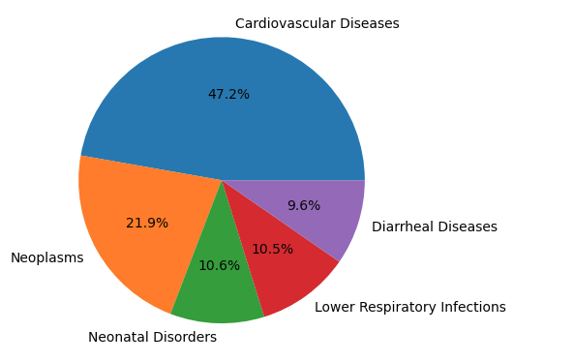
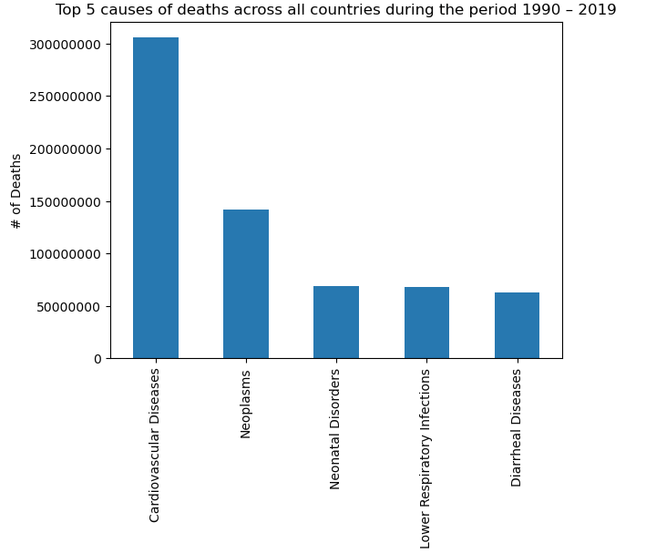
What were the top 5 causes of deaths across all countries 1990 – 2019?
Observations and Conclusions
Cardiovascular Diseases account for nearly half of the deaths out of the top 5.
Diarrheal Diseases - which are preventable and treatable - accounted for the least percentage of deaths.
Notes:
Grant when look at the top 5 death totals during this time period cardiovascular disease is the big winner it accounts for nearly 30% of deaths worldwide from 1990-2019

Slide 17
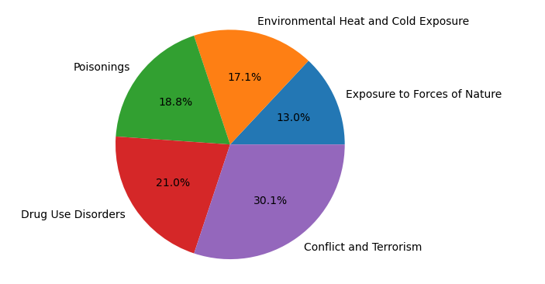
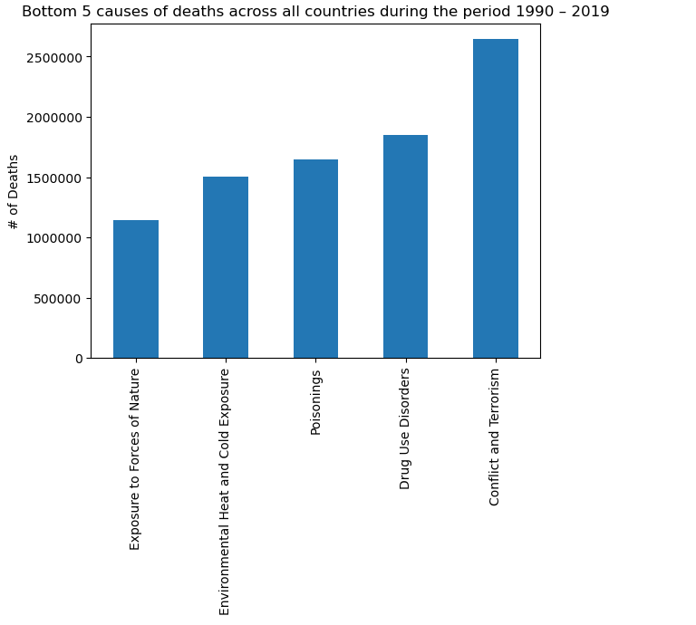
What were the bottom 5 causes of death across all countries 1990 – 2019?
Observations and Conclusions
Of the bottom 5 causes of death across all countries, nearly 20% were the result of accidental poisonings. This suggests adverse environmental conditions and lack of healthcare resources, e.g. poison control centers.
The number of deaths arising from conflict and terrorism were 50% greater than those arising from drug use disorders.
Notes:
Grant when looking at the bottom 5 causes of death during the time period most of the causes are from outside factors rather than disease like we saw in the top 5 causes

Slide 18
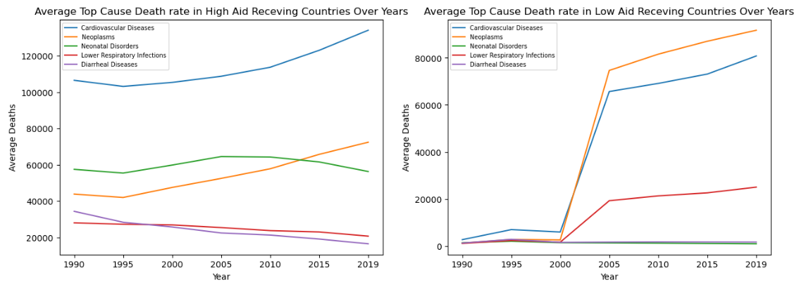
Did US foreign aid affect the average top causes of deaths in the countries receiving the most and least aid?
Observations and Conclusions
High Aid Receiving Countries: the data suggests that US aid efforts had a non-trivial, positive impact on causes of death arising from public health-related factors (respiratory infections and diarrheal disorders).
Low Aid Receiving Countries: the data suggests that the reduction/elimination of US aid had a tremendous impact from 2000 - 2019.
Notes:
Karuna

Slide 19
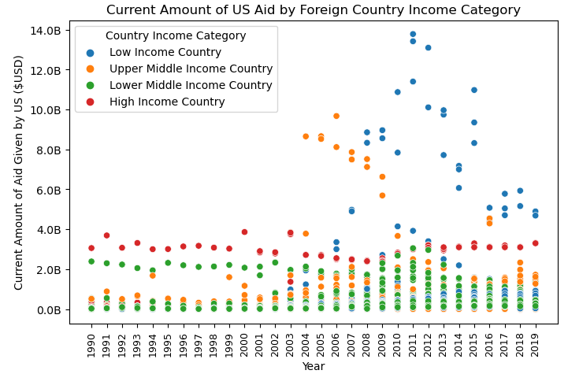
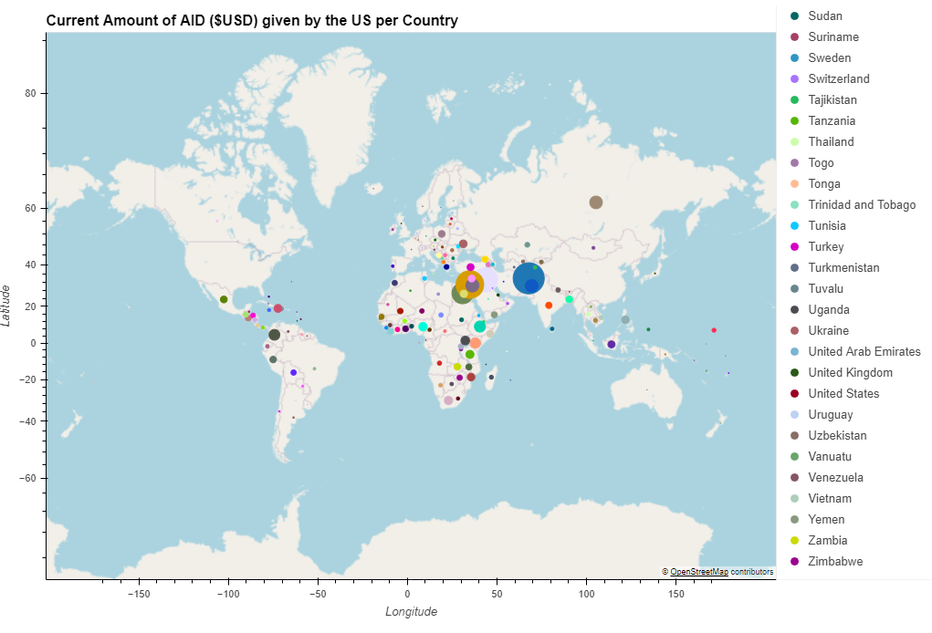
US Foreign Aid by Income Category
Observations and Conclusions
Hvplot demonstrates heatmap of all the aid given over the 30 years observed. You can see the big clusters of aid given to the Middle East during this time period.
Low Income countries, e.g. Afghanistan and Nigeria, didn’t begin receiving material aid until the early 21st century.
Notes:
Joe/Thomas

Slide 20
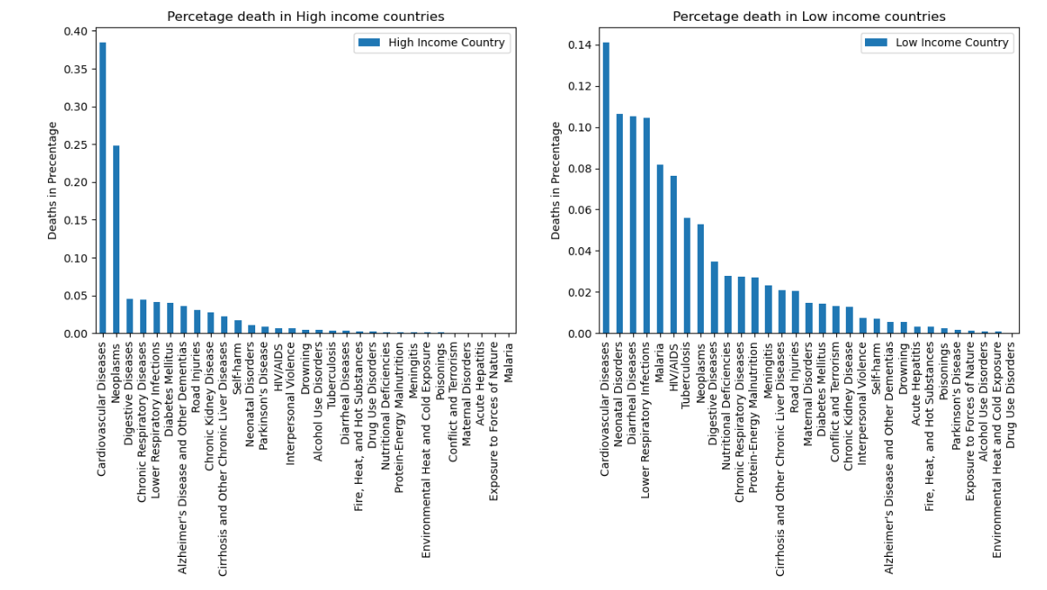
Causes of Deaths: High Income Countries vs. Low Income Countries
Observations and Conclusions
Cardiovascular diseases and neoplasms are a worldwide problem.
Deaths that can be attributable in large part to public health conditions (diarrheal, respiratory) are twice as high in low income countries than they are in high income countries.
Notes:
Karuna

Slide 21
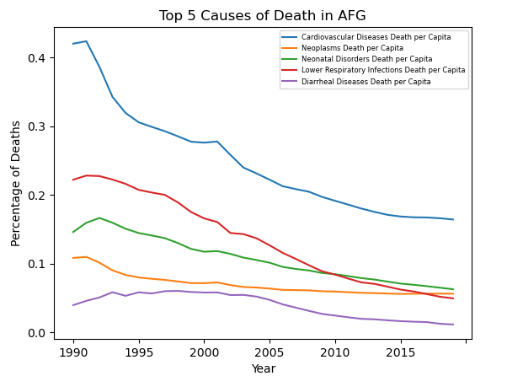
What were the top 5 causes of death in Afghanistan 1990 – 2019?
Observations and Conclusions
The general trend: a decrease in the deaths per capita for each of the top 5 causes.
Deaths per capita associated with cardiovascular diseases and respiratory infections decreased by 50%.
Notes:
Joe

Slide 22
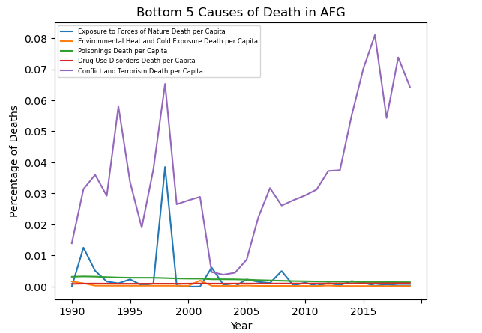
What were the bottom 5 causes of death in Afghanistan 1990 – 2019?
Observations and Conclusions
Deaths arising from conflict and terrorism skyrocketed from the mid-90s to the late 90s. The graph suggests that during this period there was a high correlation between deaths caused by conflict and terrorism and deaths caused by exposure to forces of nature.
Deaths arising from conflict and terrorism increased meteorically every year since the early 2000s.
Notes:
Joe

Slide 23
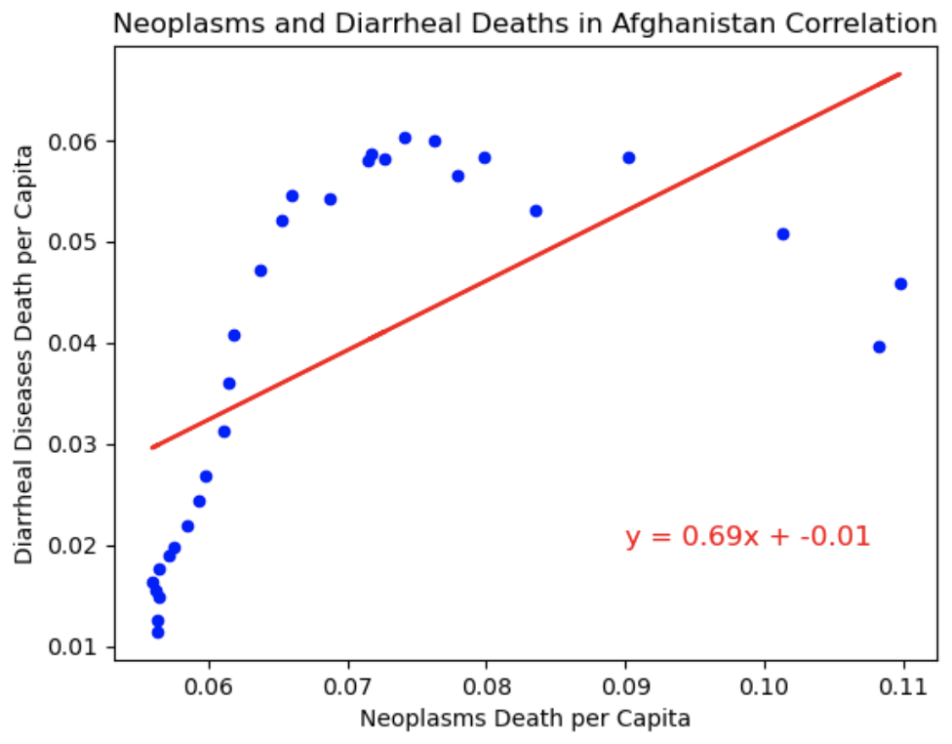
What is the correlation between the top two causes of death in Afghanistan (1990 - 2019)?
Correlation Value : 0.6
Observations and Conclusions
There is mild correlation between the top two causes of death in Afghanistan, diarrheal diseases and neoplasms
These two conditions are particularly virulent in countries with with a booming population, very young children, and inadequate/insufficient infrastructure

Slide 24
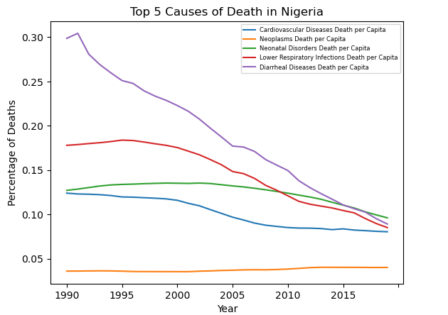
What were the top 5 causes of death in Nigeria 1990 – 2019?
Observations and Conclusions
In Nigeria, the highest number of deaths resulted from diarrheal diseases.

Slide 25
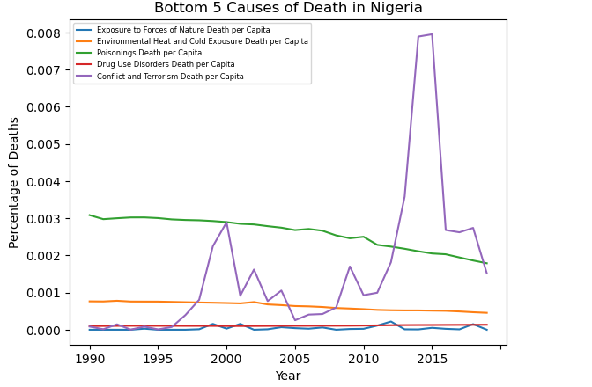
What were the bottom 5 causes of death in Nigeria 1990 – 2019?
Observations and Conclusions
Conflict and terrorism have taken a substantial toll on the inhabitants of Nigeria.
In relative terms, the number of deaths due to poisonings was 3x higher than deaths due to drug use disorders
Notes:
Joe

Slide 26
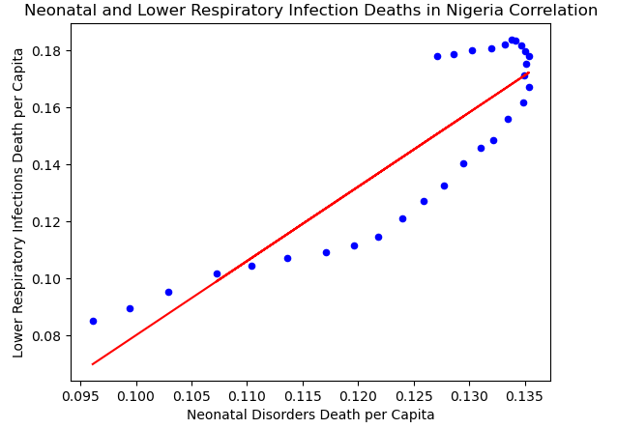
What is the correlation between two of the five top causes of death in Nigeria (1990 - 2019)?
Correlation Value: 0.89
Observations and Conclusions
The top two causes of death in Nigeria, lower respiratory infections and neonatal deaths, were highly correlated
The nature of these conditions and their apparent correlation suggests substantial inadequacy of public health resources, including sanitation, prenatal care, and malaria abatement.
Notes:
Joe

Slide 27
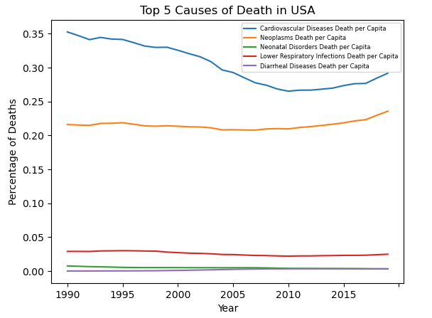
What were the top 5 causes of death in the U.S.A. 1990 – 2019?
Observations and Conclusions
The US has very little Diarrheal Deaths this is likely to how accessible clean drinking water is to citizens
Notes:
Grant

Slide 28
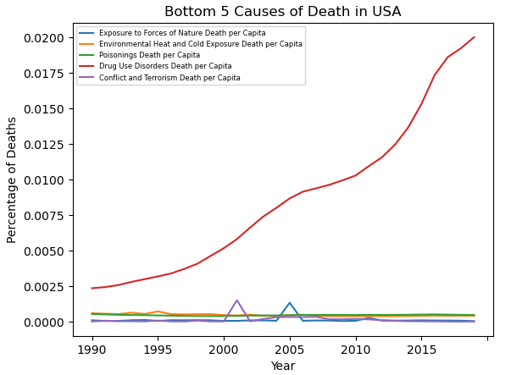
What were the bottom 5 causes of death in USA 1990 – 2019?
Observations and Conclusions
Deaths resulting from drug overdose have increased alarmingly since 1990. Per the Centers for Disease Control, synthetic opioids (primarily fentanyl) is the leading cause.
The plot shows two distinct spikes: the terrorist attacks on 9/11/2021, and Hurricane Katrina, 8/23/2005 - 08/31/2005.
Notes:
Grant

Slide 29
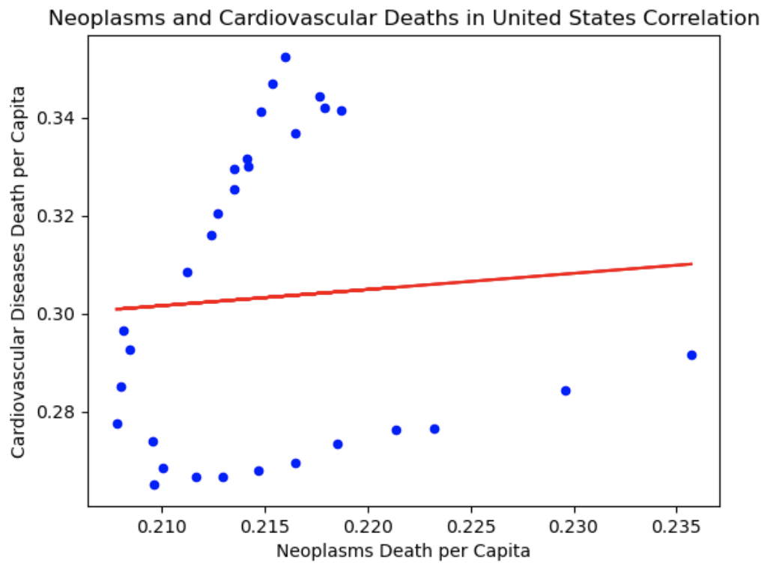
What is the correlation between the top two causes of death in the U.S.A. (1990 - 2019)?
Correlation Value : 0.07
Observations and Conclusions
The top causes of death in the US were not correlated, suggesting they both may have different precursors.
Notes:
Grant: When comparing the top 2 deaths in the us they have no correlation

Slide 30
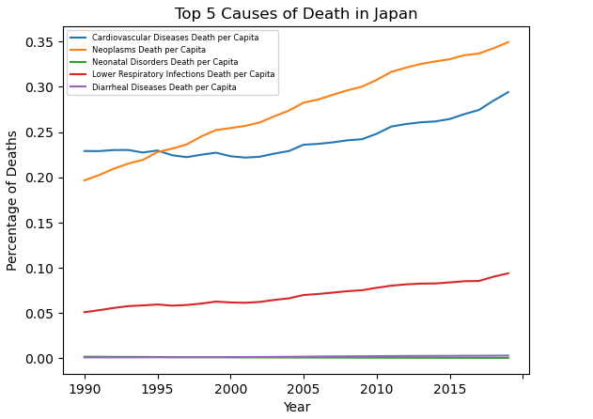
What were the top 5 causes of death in Japan 1990 – 2019?
Observations and Conclusions
The top cause of death in Japan was Cardiovascular disease, seemingly just like the rest of other high income nations. Maybe high smokers? Societal norms?
Notes:
Joe

Slide 31
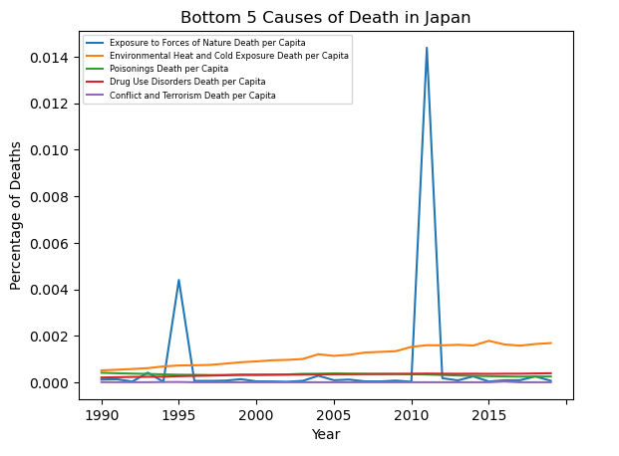
What were the bottom 5 causes of death in Japan 1990 – 2019?
Observations and Conclusions
The most impactful of the bottom five was exposure to forces of nature, seeing a huge spike in 2011 when Japan experienced one of the worlds strongest earthquakes.
Notes:
Joe

Slide 32
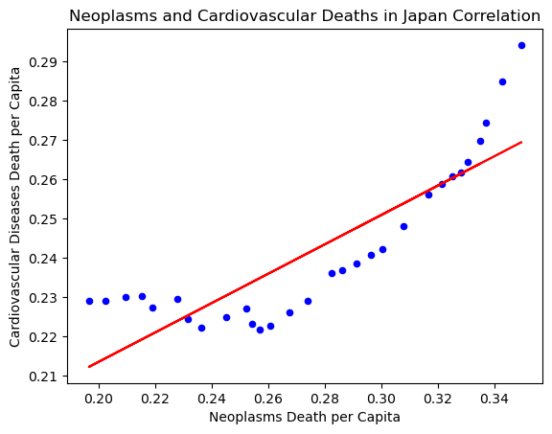
What is the correlation between the top two causes of death in Japan
(1990 - 2019)
Correlation Value : 0.86
Observations and Conclusions
Neoplasms and Cardiovascular deaths were the top two causes and they were highly correlated. They also had the same top two highest causes of death as the USA, but were much more highly correlated. Does this suggest things about health care in each country? Also, maybe we should entertain that both C.O.D.s have the same starting cause, unlike the US.
Notes:
Joe

Slide 33
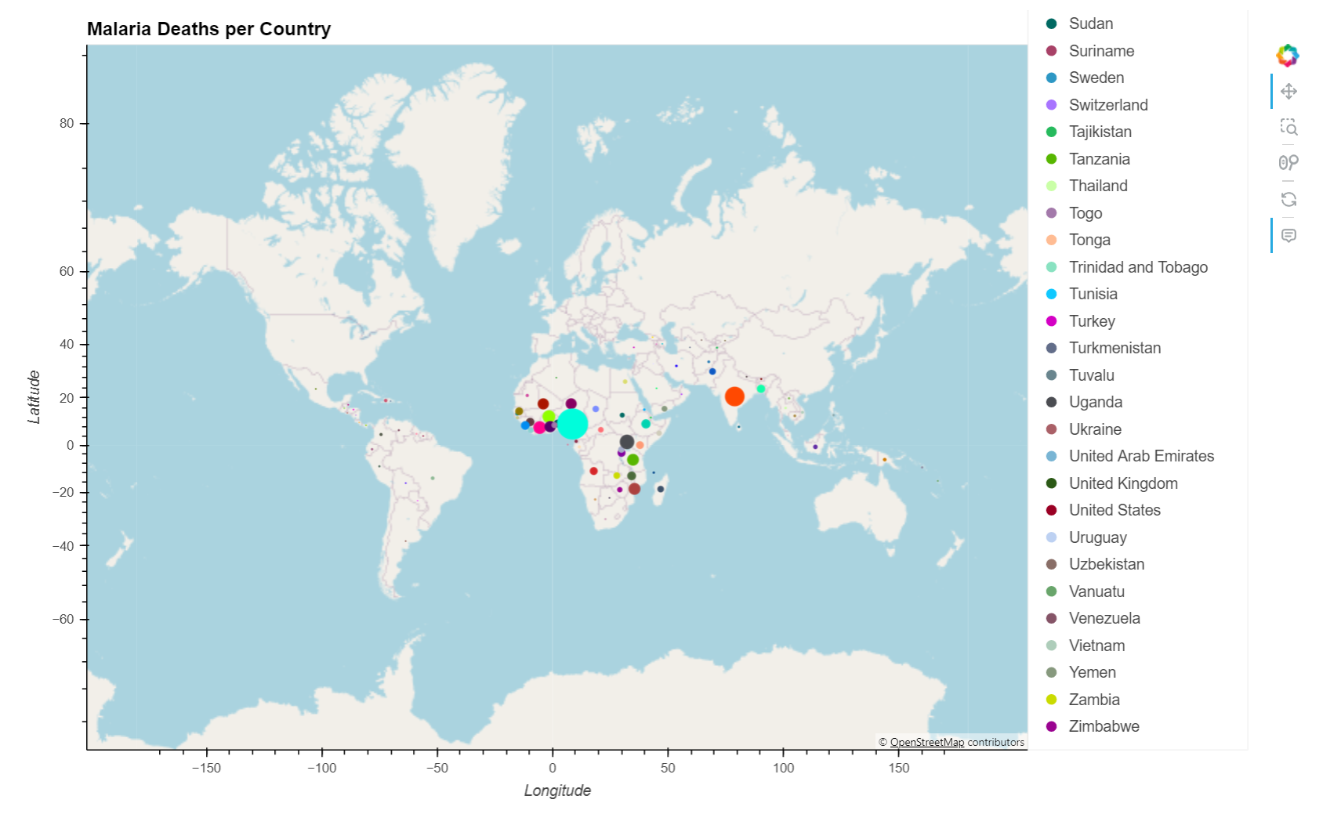
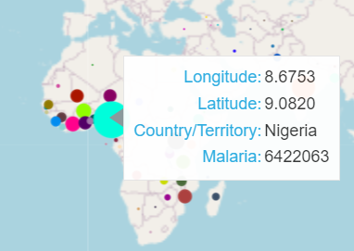
Which countries have the highest rates of death caused by malaria?
Observations and Conclusions
Malaria is transmitted via mosquitos and thus malaria has higher prevalence in areas with mosquitos
Lower respiratory infection deaths were one of the top causes of death in Nigeria (related to malaria)
Countries bordering the Gulf of Guinea are categorized as “Low Income” or “Lower Middle Income” may have a lack of resources
Notes:
Thomas - we also made an Hvplot to show the how there may be regional differences in certain diseases such as malaria. Since malaria is transmitted through mosquitoes, there is a higher prevalence of malaria deaths in areas where mosquitoes thrive such as Africa and Southeast Asia. Nigeria in particular had the greatest number of malaria deaths and lower respiratory infection which is also a byproduct of malaria. Another compounding factor could be income since lower income countries may lack the resources to have widespread malaria vaccines distributed.

Slide 34
Conclusions

Slide 35
Conclusions
Death arising from lifestyle risk factors rather than environmental factors are the leading causes of death irrespective of a country’s income classification.
Deaths arising from environmental risk factors (e.g., inadequate sanitation, safe drinking water, vector-borne disease transmission) are far greater in lower income countries than they are in high income countries.
Lower/non-aid receiving countries the death rates are due to the lifestyle diseases like cardiovascular diseases, and neoplasm. But in low-income countries, even though foreign aid has a positive impact on the death rate public health-related deaths are pretty high compared to the high-income countries.
Notes:
Deaths from lifestyle factors are a lot higher compared to environmental factors whether you look at high or low income country
Deaths due to environmental risk factors are much higher in low income countries compared to high income. A great example of this is high income countries will usually have better access to safe drinking water
High Foreign aid has a positive impact on preventing deaths in low income countries

Slide 36
Challenges and Next Steps
As pertaining to neonatal deaths in low income countries, further inquiry is warranted to determine the availability and efficacy of both prenatal care and antenatal care.
It’s essential to include other countries that provide foreign aid and merge that data into our dataframe to analyze its effects on causes of death per country. We can generate different visualizations that show the countries offering foreign aid and how that affects the causes of death per country.
It would be important to look at the rate a singular country is receiving aid across the years, while simultaneously the highest and lowest causes of death there, to make a tool used for predicting based on rates of Common Causes of Deaths, how much aid should be granted as a sufficient source to mitigate that C.O.D.
Notes:
Justin

Slide 37
Appendix

Slide 38
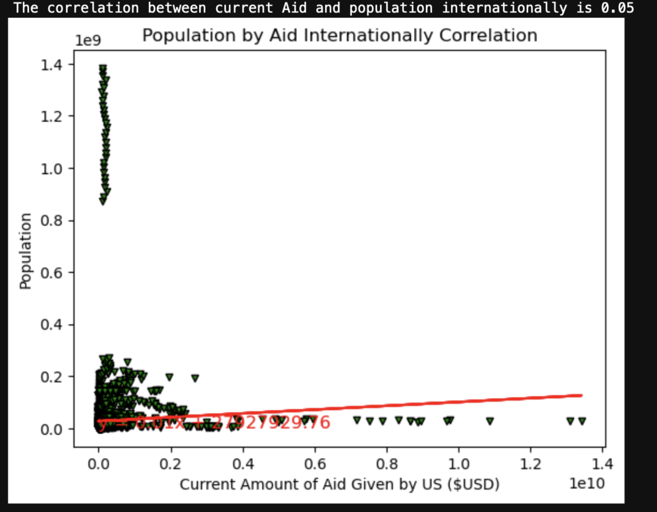
Exploratory Data Analysis
The correlation between Current Aid and Population is 0.05
Y = 0.01x + 279279
Notes:
Justin

Slide 39
Endnotes
For a discussion of the The World Bank’s country income group determination: [ https://datahelpdesk.worldbank.org/knowledgebase/articles/378833-how-are-the-income-group-thresholds-determined ]
Diarrheal disease is the third leading cause of death in children under 5 years old. It is both preventable (potable water, sanitation, hygiene) and treatable. [ https://www.who.int/news-room/fact-sheets/detail/diarrhoeal-disease ]
Poisonings (accidental): As of January 1, 2023, only 47% of World Health Organization Member States had a poisons center. The most notable gaps being in the African, Eastern Mediterranean and Western Pacific regions. [ https://www.who.int/data/gho/data/themes/topics/indicator-groups/poison-control-and-unintentional-poisoning ]
Cardiovascular diseases¹: Known as “silent killers”, these are a group of disorders of the heart and blood vessels. Behavioral risk factors are responsible for 80% of coronary heart disease and strokes. Poverty, lack of education, and unplanned urbanization can increase exposure to cardiovascular risk factors. [https://www.afro.who.int/node/5537]
Malaria: Caused by a parasite spread by mosquitoes. Children younger than 5 accounted for approximately 80% of all malaria deaths in the World Health Organization’s African Region. [https://www.afro.who.int/node/5537]
Events in Afghanistan during the period 1988 - 1999
1988: Al Qaeda is formed
1989: Peace accords signed, Soviet military withdraws from Afghanistan
1992: The Mujahadeen storm the capital and form a largely Islamic state
1995: Newly formed militia, the Taliban, rises to power. Islamic law is enforced. The USA refuses to recognize their authority
1995-1999: Continuing drought devastates farmers, renders many rural areas uninhabitable. +1M Afghans flee and languish in refugee camps.
[A historical timeline of Afghanistan, https://www.pbs.org/newshour/politics/asia-jan-june11-timeline-afghanistan]
In 2015 Nigeria saw suicide bombings and attacks by Boko Haram militants, in which thousands were killed.
Japan: On March 11, 2011, a magnitude 9.1 earthquake struck off the northeast coast of Honshu on the Japan Trench, resulting in over 18,000 dead. This earthquake was the largest in the world since 1900 [ https://www.ncei.noaa.gov/news/day-2011-japan-earthquake-and-tsunam ]
Notes:
Justin

Slide 40
Source Data
[cause_of_deaths.csv, Sourav Banerjee] https://www.kaggle.com/datasets/iamsouravbanerjee/cause-of-deaths-around-the-world, accessed March 13, 2024
[us_foreign_aid_country.csv, U.S. Agency for International Development (USAID) and U.S. Department of State on behalf of United States Government agencies reporting foreign assistance.] https://www.foreignassistance.gov/data, accessed March 13, 2024
[P_Data_Extract_From_World_Development_Indicators.zip, The World Bank Group ] https://databank.worldbank.org/reports.aspx?source=2&series=SP.POP.TOTL&country= , accessed March 13, 2024
[https://developers.google.com/public-data/docs/canonical/countries_csv, Google ] accessed March 18, 2024
Notes:
Justin

